Slide 1
Simulation
Experiment planning and results processing

Slide 2
What we should do before starting simulation?
Determine goals: what we expect from simulation?
Build mathematical model.
Choose simulation method(s).
Determine input and output parameters.
Determine how we will analyze accuracy of results.

Slide 3
Goals of simulation
Purposes
Obtain characteristics of system evolution in numerical form
Visualization of system evolution
Fields of application
Research
Computer games

Slide 4
Goals of visualization
Good look
Matching real or model processes

Slide 5
Goals of obtaining characteristics
Types of the result and purposes:
Point / interval values
Probability distribution
Sensitivity of the results to changes in parameters
Find optimal or valid values

Slide 6
Point estimation
Sample probability:
n is the total number of trials, m is the number of successes
Sample mean:
n is the sample size, X_{i} are values in the sample
Mathematical statistics
Sample variance:
unbiased estimate:

Slide 7
Distribution estimation: discrete distribution
1. When you model some random variable, you obtain its values (implementations):
2, 0, 3, 7, 1, 0, 4, 3, 2, 0, 2, 1, 1, 0, 5, 4
2. Count how many times each value have appeared. Write the result into the table:
Value | 0 | 1 | 2 | 3 | 4 | 5 | 7
Count | 4 | 3 | 3 | 2 | 2 | 1 | 1
3. Divide all counts by the total number of values (sample size). Rewrite the table:
Value | 0 | 1 | 2 | 3 | 4 | 5 | 7
Frequency | 0.25 | 0.1875 | 0.1875 | 0.125 | 0.125 | 0.0625 | 0.0625

Slide 8

Distribution estimation: discrete distribution
Values | 0 | 1 | 2 | 3 | 4 | 5 | 7
Frequency | 0.25 | 0.1875 | 0.1875 | 0.125 | 0.125 | 0.0625 | 0.0625
4. Draw polygon graph

Slide 9
Distribution estimation: continuous distribution
1. When you model some random variable, you obtain its values (implementations):
2.234, 0.167, 3.1, 3.47, 1.104, -0.345, -1,241, 2.133, -1.02, -0.546, 2.654, 1.13, -1.987, -2.02, 1.55, 3.14
2. Prepare grid of intervals:
a) (-5; -4] (-4; -3] (-3; -2] (-2; -1] (-1; 0] (0; 1] (1; 2] (2; 3] (3; 4] (4; 5]
b) min = -2.02; max = 3.47
-> (-3; -2] (-2; -1] (-1; 0] (0; 1] (1; 2] (2; 3] (3; 4]
-> (max-min) = 5.49
-> we want to have k = 5 intervals: (max-min)/5 = 5.49/5 = 1,098
-> [-2.02; -1.471] (-0.922; 0.176] (0.176; 1.274] (1.274; 2.372] (2.372; 3.47]
(in practice: take 5.49+0.01 instead of 5.49 to slightly expand the boundaries)
-> choose k using a special method

Slide 10
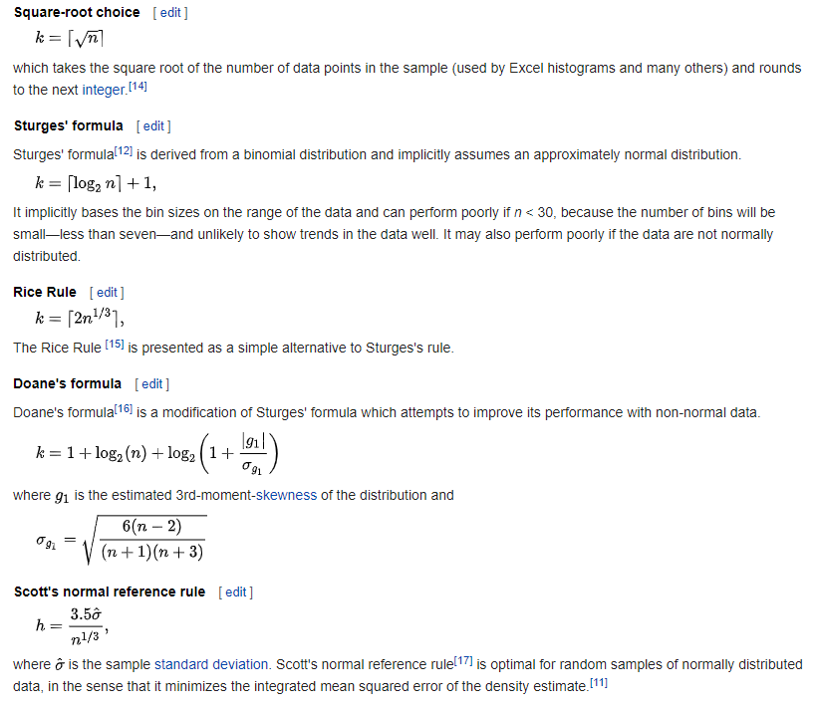
Special methods of choosing the number of intervals

Slide 11
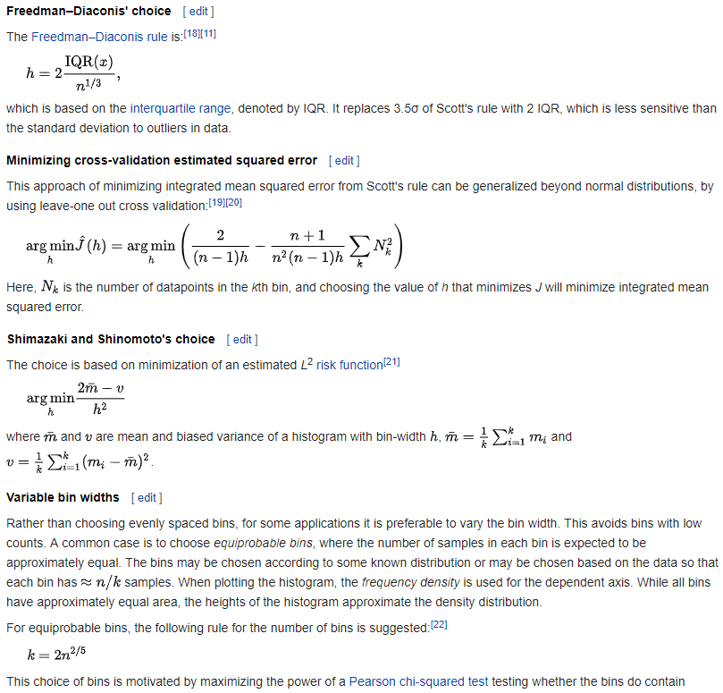
Special methods of choosing the number of intervals

Slide 12
Distribution estimation: continuous distribution
3. Count how many times values have matched to each interval. Write the result into the table:
Interval | (-3; -2] | (-2; -1] | (-1; 0] | (0; 1] | (1; 2] | (2; 3] | (3; 4]
Count | 1 | 3 | 2 | 1 | 3 | 3 | 3
4. Divide all counts by the total number of values (sample size). Rewrite the table:
Values | (-3; -2] | (-2; -1] | (-1; 0] | (0; 1] | (1; 2] | (2; 3] | (3; 4]
Frequency | 0.0625 | 0.1875 | 0.125 | 0.0625 | 0.1875 | 0.1875 | 0.1875

Slide 13
Distribution estimation: continuous distribution
Values | (-3; -2] | (-2; -1] | (-1; 0] | (0; 1] | (1; 2] | (2; 3] | (3; 4]
Frequency | 0.0625 | 0.1875 | 0.125 | 0.0625 | 0.1875 | 0.1875 | 0.1875
5. Draw histogram graph:

Slide 14
Analysis of the result accuracy
1. You may compare the result with:
analytical results (for special cases)
numerical results (derived by another way)
known facts, values from practice
2. Make sensitivity analysis of the result

Slide 15
The result accuracy: point estimations
The result of estimation
Value for comparison x
Absolute error:
Relative error:

Slide 16
The result accuracy: distributions
Visual testing

Slide 17
The result accuracy: distributions
Measure the accuracy:
Kolmogorov distance
F(x) and F_{sim}(x) are CDFs of distributions to compare
L1 norm
Hellinger distance
f(x) and f_{sim}(x) are PDFs (or PMFs) of distributions to compare
. . .

Slide 18
The result accuracy: distributions
Use Mathematical Statistics to check hypothesis about the distribution type

Slide 19
Sensitivity (stability) analysis

Slide 20
Main problems
If it does not work / does not match proper values or behavior, check:
1) does the sample size is enough;
2) source code of the program;
3) algorithm of simulation;
4) sensitivity / stability of results;
5) does the state of the system satisfy Markov property;
6) were the statistics processed correctly;
7) correctness of template results (with which we compare);
8) algorithms of random objects generators, quality of base generator.

Slide 21
Size of sample
Modeling discrete uniform distribution {1, 2, 3, 4, 5, 6}
Sample size = 10

Slide 22
Size of sample
Sample size = 100
Sample size = 1 000
Sample size = 10 000

Slide 23
Size of sample
Sample size = 100 000
Sample size = 1 000 000

Slide 24
Laboratory #8
It is time to complete it!

Slide 25
Projects #D, #E, #F, …
Simulation of software development process
The movement of the planets of the Solar system
Space merchant (physics + economy)
Economic games:
car repair shop
Cafe
the work of the hall in the bank
goods delivery
Predators / prey (agent modeling)
Single-channel radio network
Communication system of a group of autonomous uninhabited underwater vehicles
Smart House
Robot Vacuum Cleaner
Splitting data streams
TCP protocol modeling
Simulation of traffic:
highway
crossroads
Calculation of integrals (Monte Carlo method)
Application for designing and modeling using system dynamics flow diagrams
Any other models that use continuous, discrete-event, agent-based modeling and/or system dynamics.

